Slide 1
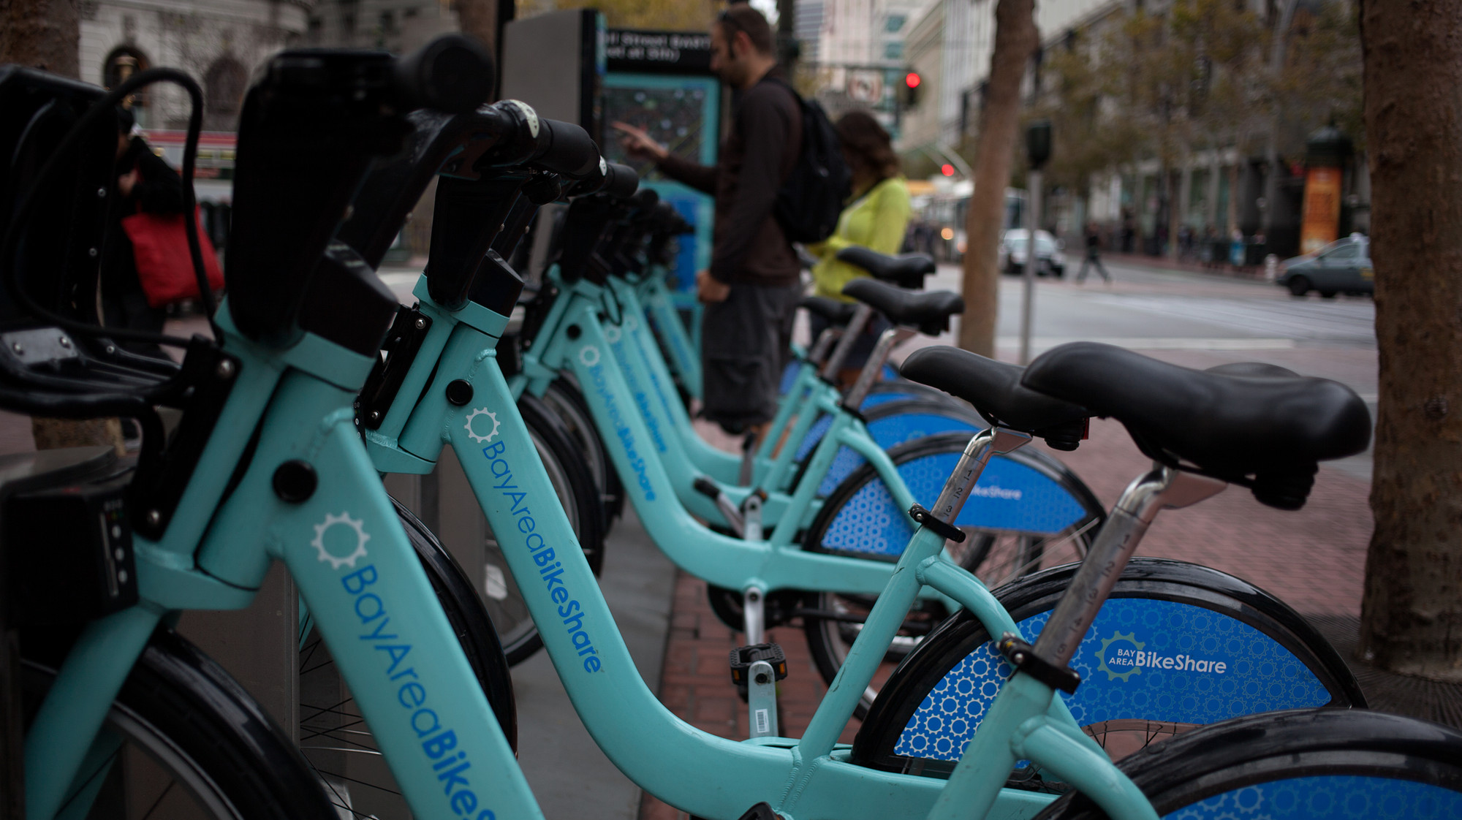
Business data Analytics & prediction
EDA: Bikes_Trips_San_Fransisco
Group 5: Yarden, Omer & Amitai

Slide 2
The Business Question
How can we increase usage of bike-sharing in San Francisco?

Slide 3
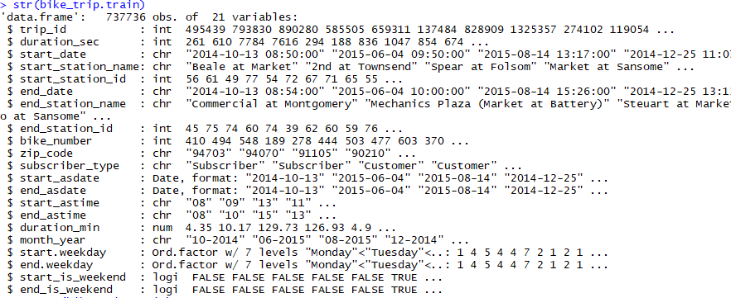
Data Summary
Main data set + two assisting tables

Slide 4
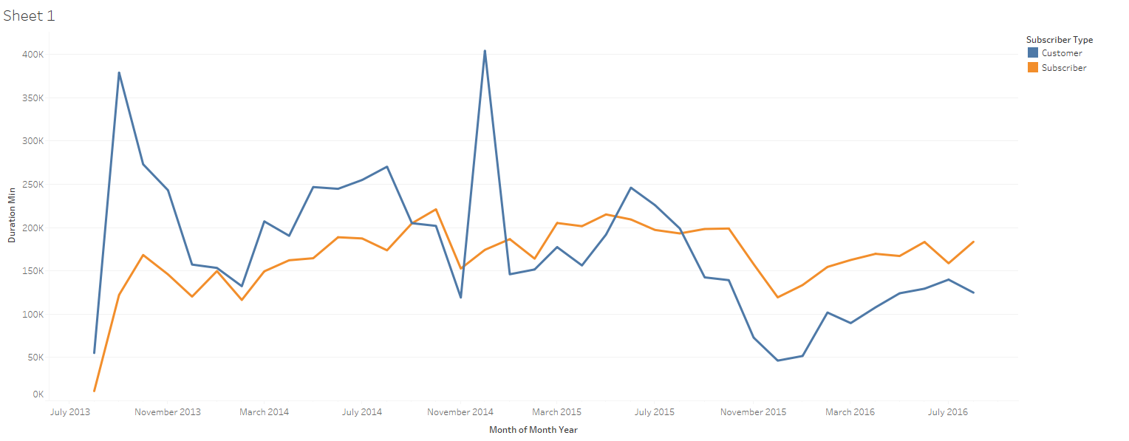
The problem
Usage = time ridden. Month over month

Slide 5
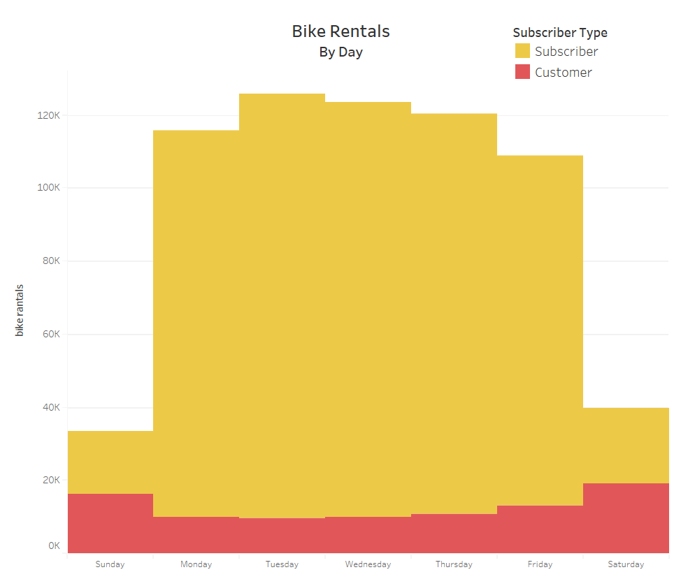
Analyzing the data
Usage by day

Slide 6
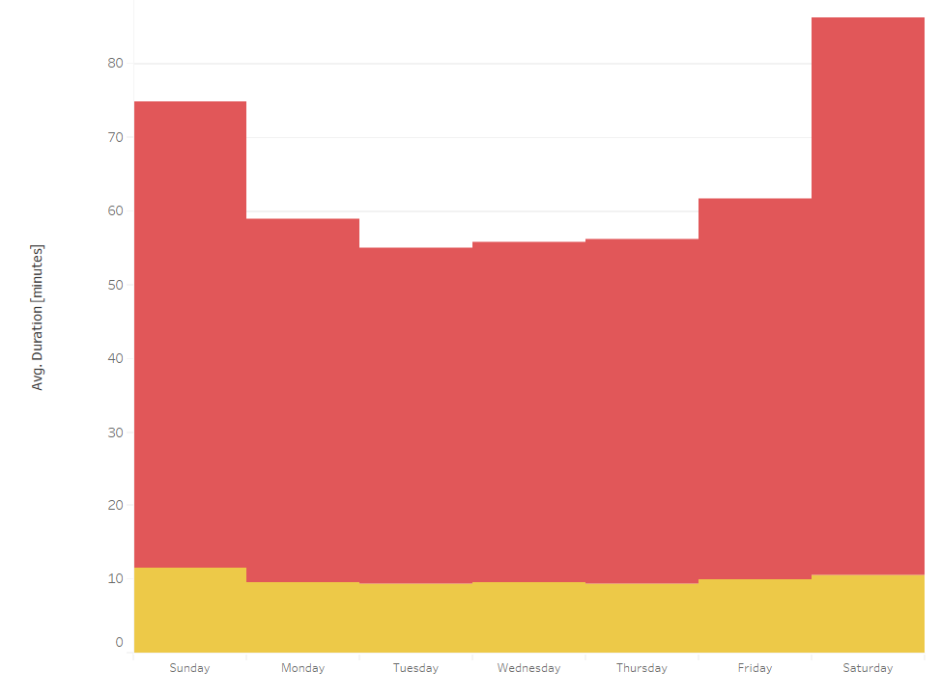
Analyzing the data
Trip time by day

Slide 7
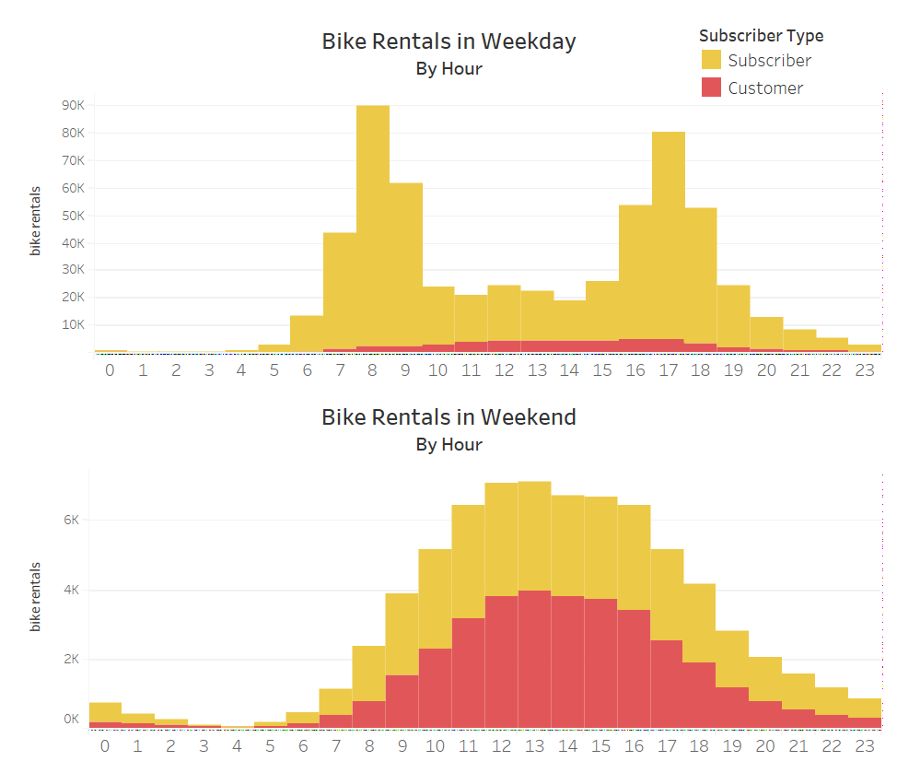
Analyzing the data
Trip by time of day
Weekday

Slide 8
Analyzing the data
Trip by time of day
Weekend

Slide 9
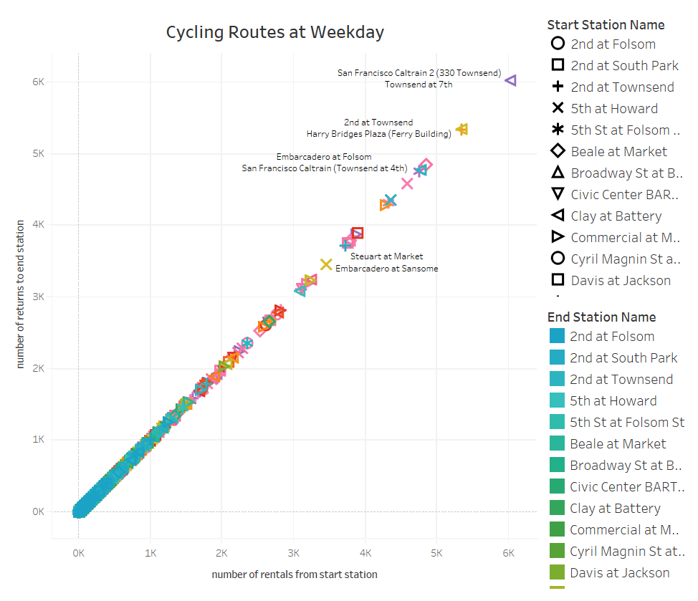
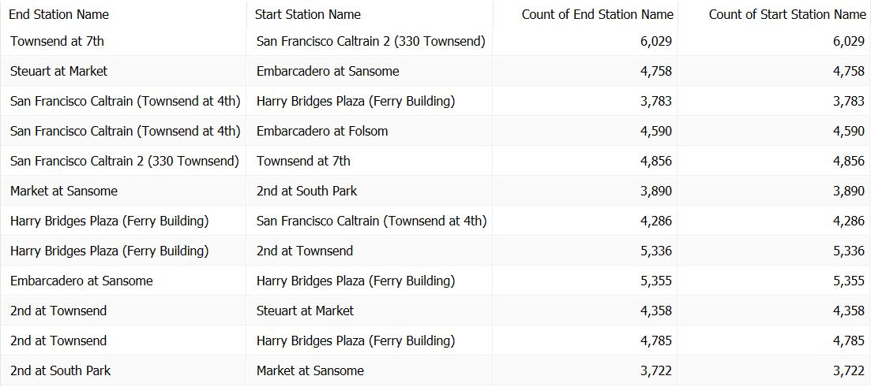
Analyzing the data
Trip by time of day

Slide 10
What can make a station popular?

Slide 11
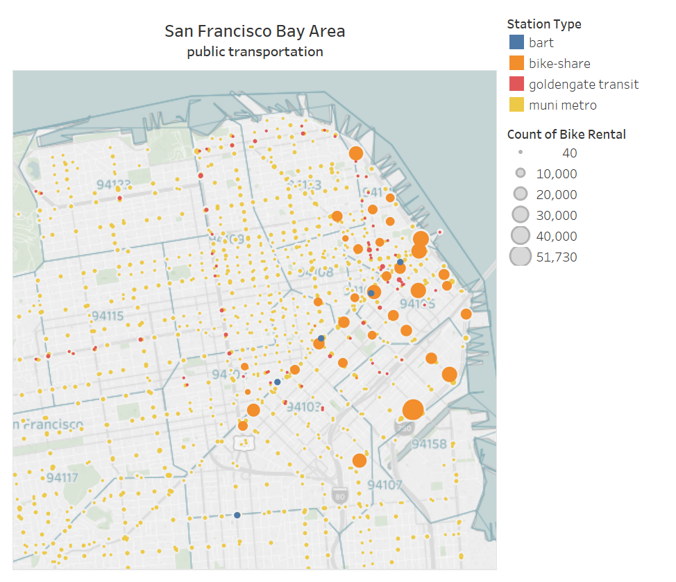
Analyzing the data
Station on map overview

Slide 12
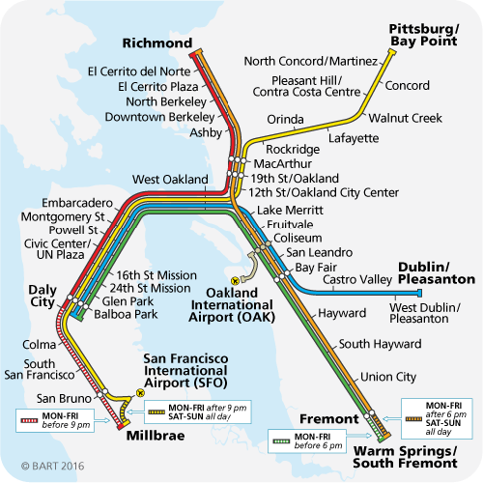
Analyzing the data
Station on map overview

Slide 13
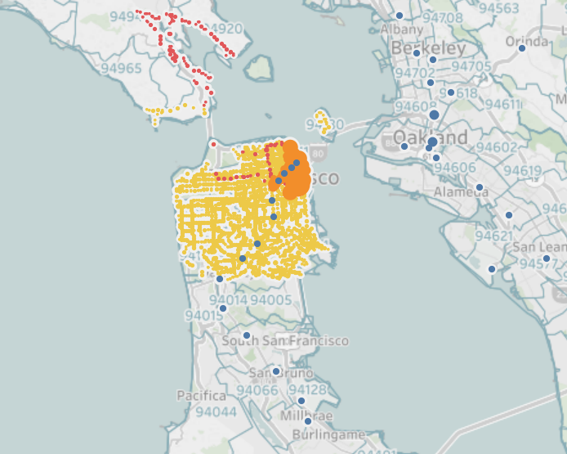
Analyzing the data
Station on map overview

Slide 14
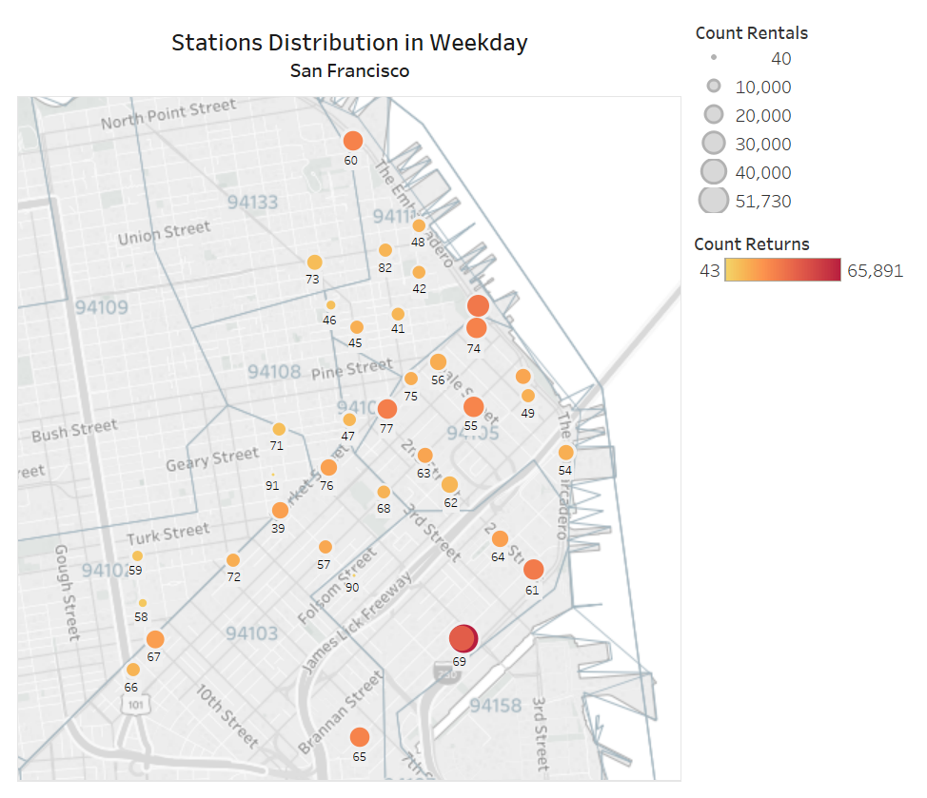
Analyzing the data
Weekday
Station on map overview

Slide 15
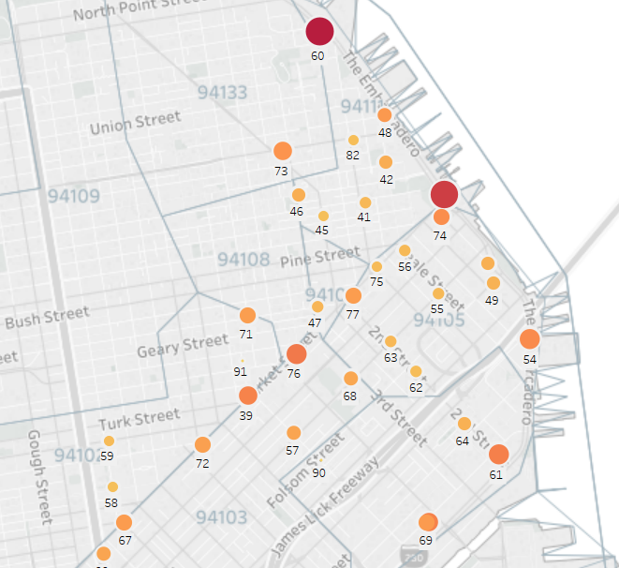
Analyzing the data
Weekend
Station on map overview

Slide 16
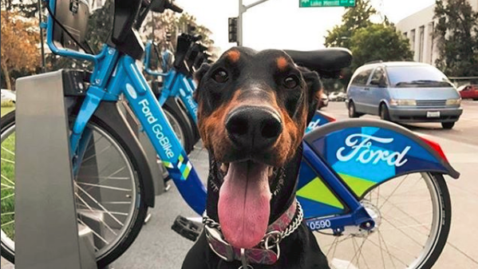
So, how do we maximize usage?
Dude, where is my bike?

Slide 17
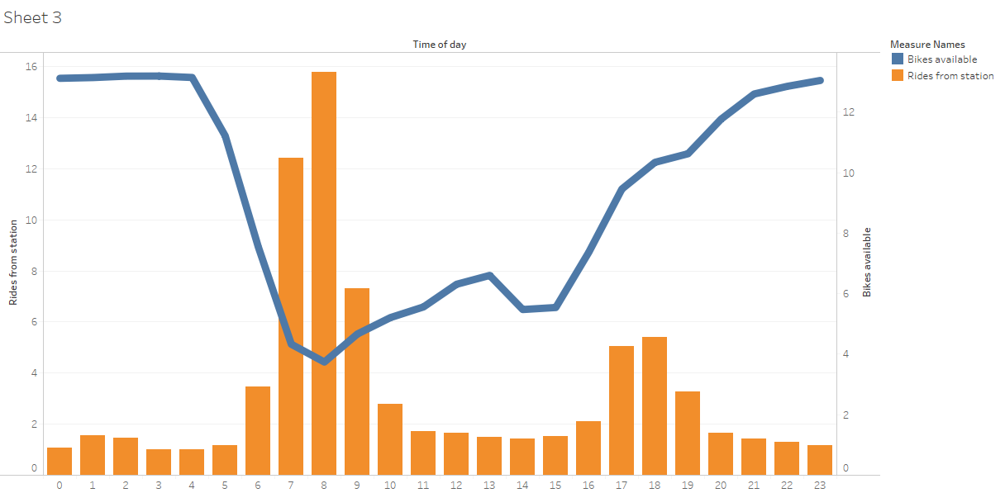
Investigate unbalanced stations
No less than 2 available bikes at any given time

Slide 18
What’s next?
Dig dipper
Investigate unbalanced stations for all stations
Bring more data sources in order to fully map popular stations
Build prediction model for number of rides from a given station per time of day
Build prediction model for station running out of bikes

Slide 19
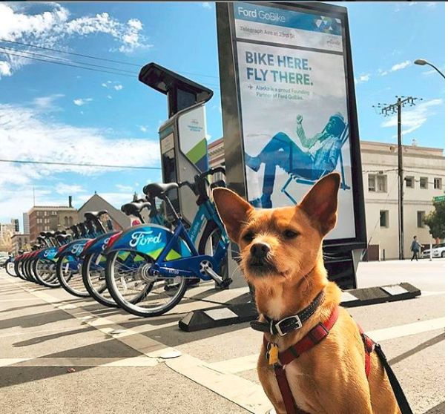
Did anyone see my EDA?

